Slide 1
Latham Fire
Sprint 1
Alphabit Soup

Slide 2
Overview
Web Application for a fire department
Chiefs can quickly organize firetrucks
Notes:
Our assignment was to develop a web application for a fire department so that the fire chiefs, or the ones who have to organize which firefighters to put on which firetrucks can do so via the web application. The goal is to automate information about firefighters and their qualifications so that those can be kept up to date, as well as making it faster and easier for a chief to see who is responding to a call and how they will organize their trucks based on the responding firefighters and quickly.

Slide 3
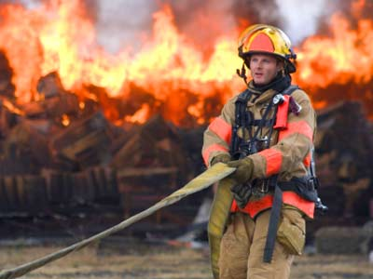
Things to Consider
Different types of trucks
Qualifications of FFs
Number of FFs per truck
Firefighters need to know where they are assigned

Slide 4
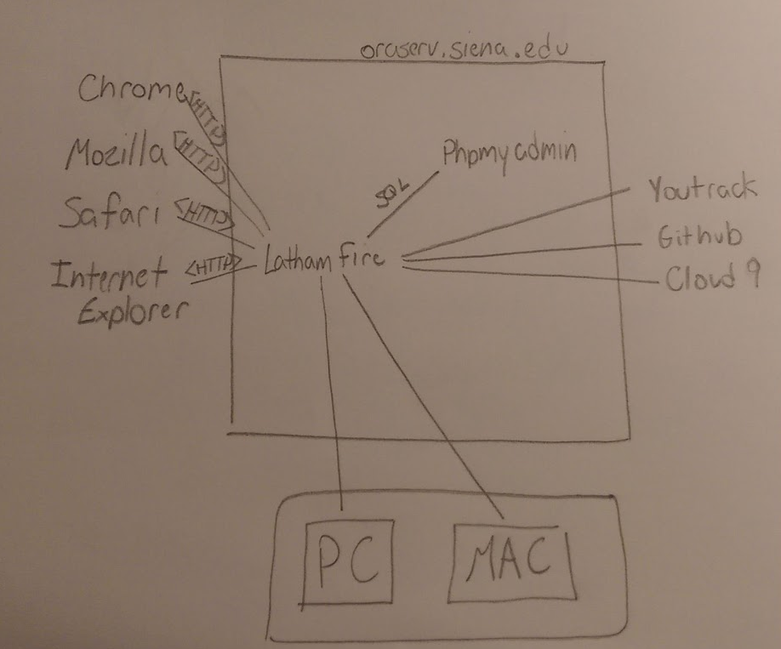
Deployment Diagram

Slide 5
User Stories

Slide 6
User Story 1
Acceptance Criteria
As a Commanding officer,
I want to have a login form,
So that I can input my credentials.
I can go to the login page.
I can enter in a username.
I can enter in the corresponding password.
I can submit the username and password.

Slide 7
Login Form

Slide 8
User Story 2
Acceptance Criteria
As a commanding officer
I want to be able to drag firefighters into respective trucks
So that I can efficiently load the fire trucks
I can click on a firefighter and drag it around the page.
I can drop a firefighter into a respective truck and the web page will respond.

Slide 9
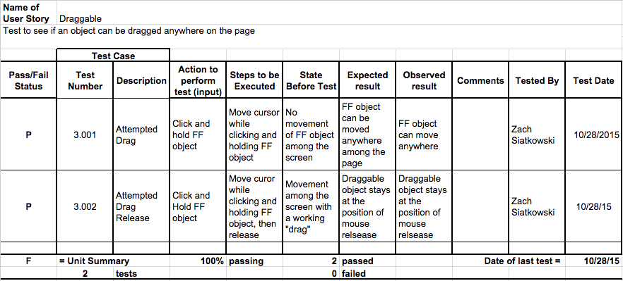
Draggable

Slide 10
User Story 3
Acceptance Criteria
As a commanding officer
I want to be able to access every page required
So that I can organize firetrucks
I want to have a clearly visible navigation bar that is the same throughout the website.
I want to have a web page where everything is clearly readable.

Slide 11
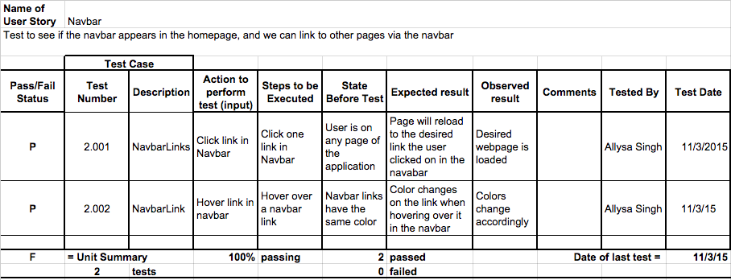
Navbar

Slide 12
User Story 4
Acceptance Criteria
As a commanding officer
I want access to all firefighter information
So that I can more efficiently fill firetrucks.
I want a database that holds all firefighter information, including:
name
firefighter ID
type of qualification
years certified
administrative capabilities.

Slide 13
Database Design

Slide 14
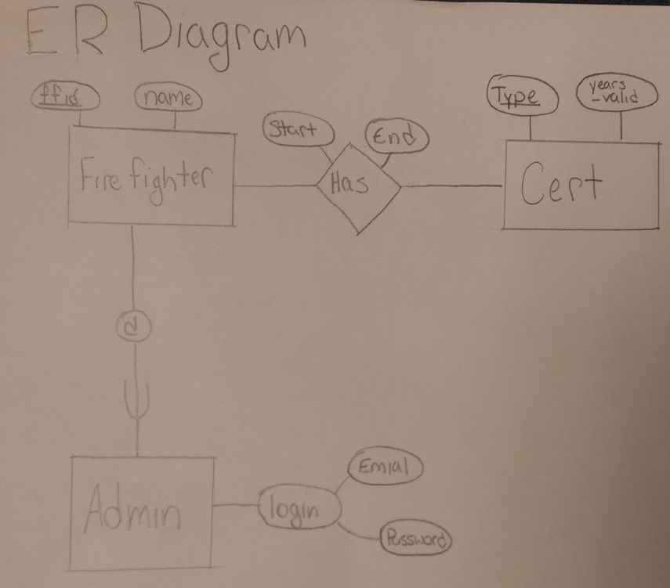
ER Diagram
Four total relations containing three entities and one relationship
Cert Entity: Each certification will only be stored once in the DB
“Has” relationship: exists to see certifications of each firefighter
Admin enhanced entity relation: Admin inherits all attributes of the Firefighter entity

Slide 15
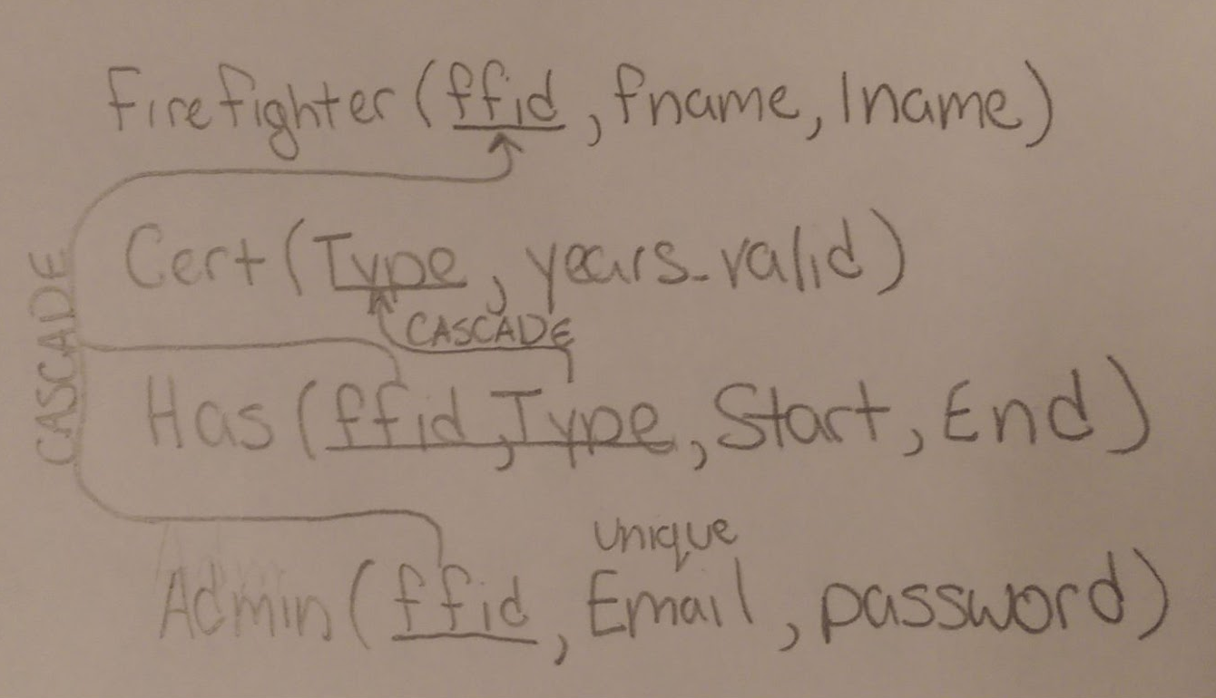
Relational Schema
All relations are in BCNF
Admin inherits all attributes - not needed in the relation
ffid: The primary key in Admin and references the Firefighter relation
All redundancies have been accounted for and eliminated

Slide 16
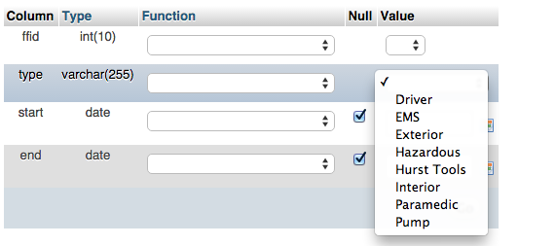
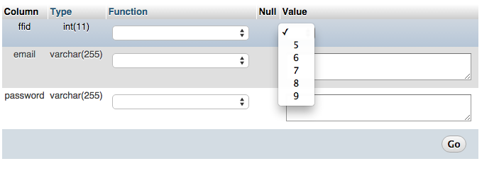
Sample Data
The ffid (firefighter ID) automatically increments when a new Firefighter is added
The drop-down menu contains all certifications a firefighter may have
Has relationship foreign keys: type, ffid
Improper certification type and ffid can not be entered

Slide 17
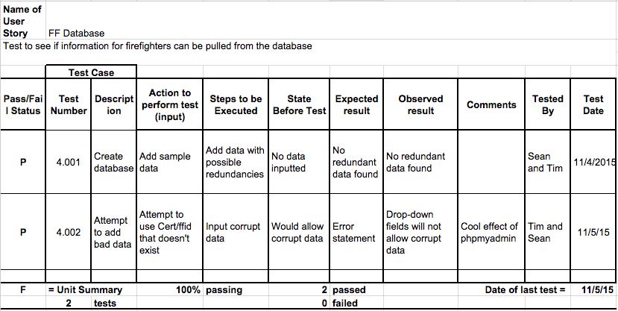
Firefighter Database

Slide 18
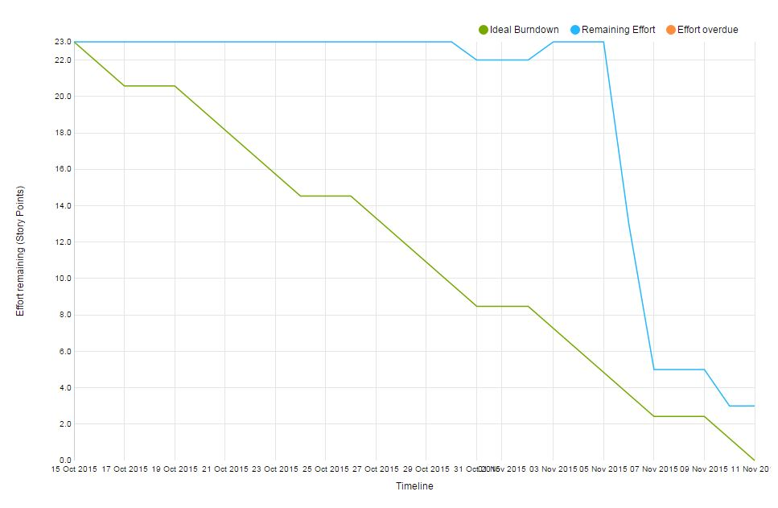
Sprint Burndown Chart

Slide 19
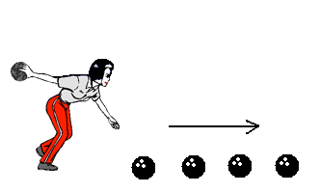
Velocity Measurement
Total story points: 23 points
Completed story points: 20 points
Average velocity after our first sprint: 20 points
Projection for sprint 2: 26 points

Slide 20
Latham Fire Demo

Slide 21
Drag and Drop Demo

